Slide 1
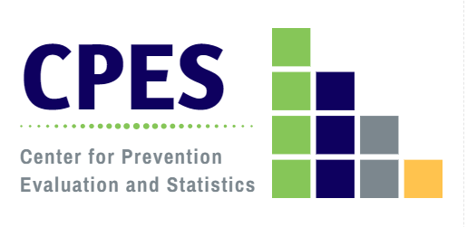
Trends in Substance Use in Connecticut and the Impacts of COVID-19
Alcohol and Drug Policy Council
October 20, 2020
Jane A. Ungemack, DrPH
DMHAS Center for Prevention Evaluation and Statistics (CPES)
at UConn Health

Slide 2
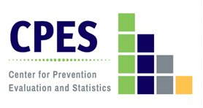
Percent of Persons Reporting Use by Substance, Ages 12 and Older: CT vs. US, 2017-2018
Source: NSDUH, 2018
Note: Tobacco products include cigarettes, smokeless tobacco (i.e., snuff, dip, chewing tobacco, or snus), cigars, or pipe tobacco
Notes:
+This table, based on NSDUH data, shows the historical reality of substance use in CT vs. the nation: CT typically has higher rates of use than found nationally with a few exceptions.
One of those exceptions has been prescription pain reliever misuse. Our rates have not been significantly different from the national average since I first started monitoring substance use trends in the state 20 years ago. We have, however, had historically higher rates of heroin use (and treatment admissions) compared to the US for decades.

Slide 3
Percent of Youth and Adults Reporting Past Month Alcohol Use and Binge Drinking: Connecticut, 2008-2018
Source: NSDUH
Note: The 2015 NSDUH underwent significant redesigns. In 2015 the threshold for binge drinking changed for women from 5 to 4

Slide 4
Percent of High School Students Reporting Past 30-Day Alcohol Use and Binge Drinking: Connecticut, 2005-2019
Source: CSHS (CT YRBS)
Notes:
The YRBS trend data for the same period of time validates the results of the NSDUH trends; whether a household personal interview or an in-school group administration, both data sets show the decrease in underage drinking. The comparison of the YRBS and NSDUH data, however, indicate that the method of data collection do impact the level of reporting, with anonymous, group-based administration resulting in approximately twice the prevalence of reported alcohol use among adolescents. It should be further noted that the NSDUH includes a broader age group (12-17) than the YRBS which primarily includes 14-17 year old high school students. It is likely that the NSDUH underreports that actual prevalence of substance use behavior.

Slide 5
Past Month Tobacco Product Use by Age Group, Connecticut, 2008-2018
Note: Tobacco product use includes cigarettes, smokeless tobacco (i.e., snuff, dip, chewing tobacco, or snus), cigars, or pipe tobacco.
Source: NSDUH

Slide 6
Tobacco Sales to Youth in Connecticut:
SYNAR, CDC & DMHAS, 2008-2018

Slide 7
Percent of High School Students Reporting Past 30-Day Use of Electronic Vapor Products vs. Cigarettes:
Connecticut, 2011-2019
Source: CSHS (CT YRBS)
Note: The language around electronic vapor products has changed over the years. In 2017 and earlier, the survey asked about current “e-cigarette” use rather than vapor products.

Slide 8
Substances Used by E-cigarette Users in Vaping Devices Reported by Young Adults 18-25: Connecticut, 2020
N = 452
Source: Young Adults Statewide Survey

Slide 9
Past Year Marijuana Use by Age Group:
CT vs. US, 2008-2018
Source: NSDUH, 2018

Slide 10
Percent of Persons Perceiving Great Risk from Smoking Marijuana Once a Month by Age Group: Connecticut, 2009-2018
Note: The 2015 NSDUH underwent significant redesigns, including the order of perceived risk questions, affecting comparability.
Source: NSDUH

Slide 11
Percent Reporting Past Year Cocaine Use by Age Group: Connecticut, 2009-2018
Notes:
This slide shows that 18-25 year olds and adults 26+ are the groups at increased risk of cocaine use. Both have increased almost 50% since 2009-2010. Again adolescents are not sharing this risk; cocaine use among 12-17 year olds appears to have dropped slightly.

Slide 12
Cocaine-involved Overdose Death Rate (per 100,000) by 5 CT Community Type, 2012-2019
Source: Office of the Chief Medical Examiner
Note: Death rate by town of residence

Slide 13
Percent of Persons Reporting Past Year Non-Medical Use of Pain Relievers, by Age Group: Connecticut, 2009-2018
Source: NSDUH, 2018
Notes:
Trend data from the 2009-2016 NSDUH surveys show that uniformly over time young adults ages 18-25 have the highest rates of non-medical use of prescription drugs compared to adolescents ages 12-17 and adults 26 and older. While the rates of NMUPD appear relatively unchanged in the youth population, the rates of prescription misuse appeared to decline among young adults (11.1% in 2009-2010 to 7.18% in 2015-2016)

Slide 14
Percent of High School Students Reporting Ever Misusing Prescription Pain Medicine: CT vs. US, 2009-2019
Note: The wording of this question has changed over the years. In 2015 the question asked about taking prescription drugs without a prescription, but didn’t specify pain medicine. In 2013 and earlier, it asked about taking drugs without a prescription to get high.

Slide 15
Number of Opioid Prescriptions per Year: Connecticut, 2014-2018
Source: CPMRS, Department of Consumer Protection

Slide 16
Percent of Persons Reporting Past Year Use of Heroin by Age Group: CT vs. US, 2014-2018
2019 US 12-17 wasn’t reported out due to low precision
Source: NSDUH

Slide 17
Number of Opioid-related Emergency Department Visits and Hospital Admissions: Connecticut, 2013-2018
Source: CT DPH

Slide 18
Number of Overdose Deaths by Year: Connecticut, 2012-2019
Source: Office of the Chief Medical Examiner
Notes:
Mean number of substances involved in overdoses in 2012= 1.6 compared to 2.3 in 2018
(includes alcohol, fentanyl, heroin, cocaine, any benzodiazepine, prescription opioids (counted individually), methamphetamine, methadone)
Due to the way data was reported, fentanyl analogues were not included separately from fentanyl, and thus these counts represent underestimates, since decedents may have positive toxicology for 1 or more fentanyl analogue. Also, decedents may have had >1 benzodiazepine, and these were not able to be counted individually.

Slide 19
Multiple Drugs Involved in Opioid Overdose Deaths: CT, 2019
Prescription Opioid-Involved Deaths
(n=133)
Heroin-Involved Deaths
(n=387)
*Prescription opioids include oxycodone, oxymorphone, hydrocodone, hydromorphone and tramadol.
Substances that are underlined indicate deaths that involved only that substance (e.g., fentanyl-involved deaths involving only fentanyl and no other substances listed).
Source: Office of the Chief Medical Examiner

Slide 20
Opioid Overdose Mortality Rate by Age Group: Connecticut, 2012-2019
Source: Office of the Chief Medical Examiner
Notes:
In the US in 2017, 68% of all overdose deaths involved opioids, compared to 92% and 93% of overdoses in CT in 2017 and 2018, respectively

Slide 21
Opioid-involved Overdose Death Rate (per 100,000) by 5 CT Community Type: Connecticut, 2012-2019
Note: Death rate by town of residence
Source: Office of the Chief Medical Examiner

Slide 22
Opioid Overdose Mortality Rate per 100,000 by Race/Ethnicity: Connecticut, 2012-2019
Source: Office of the Chief Medical Examiner

Slide 23
Drug Seizure Submissions by Year: Connecticut, 2014-2019
Source: US DEA, Diversion Control Division, 2014-2019. Springfield, VA: US Drug Enforcement Administration. Retrieved from: https://www.nflis.deadiversion.usdoj.gov/Resources/NFLISPublicResourceLibrary.aspx
*All fentanyl-related substances includes:
fentanyl, 4-fluoroisobutyryl fentanyl, acetyl fentanyl, acryl fentanyl, carfentanil, cyclopropyl fentanyl, furanyl fentanyl, U-47700, ANPP, butyryl fentanyl, fluoroisobutyryl fentanyl, methoxyacetyl fentanyl, o-fluoro acryl fentanyl, valeryl fentanyl, p-fluoroisobutyryl fentanyl, and p-fluorobutyryl fentanyl.

Slide 24
Problem Substances of Greatest Concern for Age Groups, According to Key Informants: Connecticut, 2020
Source: Community Readiness Survey 2020
Notes:
Weighted percents

Slide 25
COVID-19

Slide 26
Prevalence of Increasing/Initiating Substance Use and Adverse Mental Health Outcomes Associated with COVID-19: US, June 24-30, 2020
Czeisler MÉ, Lane RI, Petrosky E, Wiley JF, Christensen A, Njai R, Weaver MD, Robbins R, Facer-Childs ER, Barger LK, Czeisler CA, Howard ME, Rajaratnam SMW. Mental Health, Substance Use, and Suicidal Ideation During the COVID-19 Pandemic - United States, June 24-30, 2020. MMWR Morb Mortal Wkly Rep. 2020 Aug 14;69(32):1049-1057. doi: 10.15585/mmwr.mm6932a1. PMID: 32790653; PMCID: PMC7440121.
Notes:
Survey administered in June 2020 and weighted to achieve representativeness of this sample to the US population by gender, age, and race/ethnicity (using 2010 US Census data).
Adverse MH/BH symptoms defined as anxiety or depressive disorder, COVID-19 related TSRD (PTSD, Acute Stress Disorder, Adjustment Disorder), Starting/Increasing SU, or Serious Consideration of Suicide
SU defined as use of alcohol, legal or illegal drugs, or non-medical use of Rx drugs.
**Note that for last 2 variables on right, education & income, there are multiple categories between the lowest/highest values which are shown; for both education and income, there is a linear association between increasing prevalence of any adverse MH and BH symptom and both lower education and lower income. There is not a clear trend for prevalence of SU initiation/increase for income, but there is one for education.

Slide 27
Young Adults Statewide Survey Health and behavior indicators that increased as a result of COVID-19
85.8%
83.2%
80.8%
75.7%
42.1%
39.3%
21.9%
Source: Young Adults Statewide Survey

Slide 28
Past Month Substance Use Among Young Adults 18-25:
Connecticut, 2020
N = 777
*heavy alcohol use: 5 or more drinks on one occasion
Source: Young Adults Statewide Survey

Slide 29
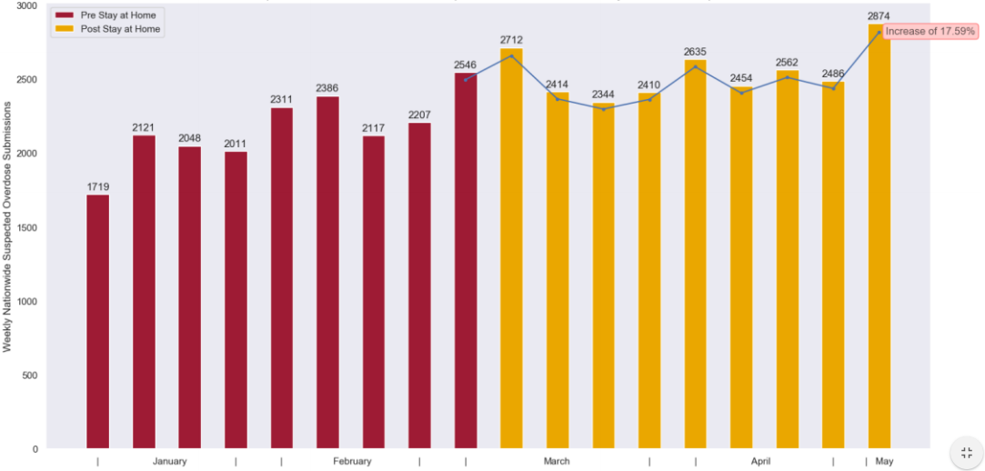
Suspected Overdoses Since Onset of COVID-19 Impact: Connecticut, 2020 (ODMAP Submissions)
http://www.odmap.org/Content/docs/news/2020/ODMAP-Report-June-2020.pdf
Notes:
Overdose Detection Mapping Application Program is syndromic surveillance data- near real-time suspected overdose data nationally
Maintained by Washington/Baltimore High Intensity Drug Trafficking Area (HIDTA) and University of Baltimore Center for Drug Policy and Enforcement
In the time following March 19, 2020, 61.8% of participating counties experienced an increase in overdose submissions
17.6% percent increase in suspected overdose submissions when comparing the weeks prior to and following the commencement of state mandated stay-at-home orders.
The number of spike alerts generated by the ODMAP system have increased as well as the number of counties experiencing a spike and the duration in days of observed spikes
Detected overdose clusters have shifted from traditional centralized, urban locations to adjacent and surrounding suburban and rural areas.
Limitations
Lack of non-fatal historical data
Prevalence of naloxone use by laypersons
Seasonality
Unemployment/economic factors
Evolution of drug trends, including stimulant and synthetic opioids (fentanyl)
Inconsistent reporting and definitions of suspected overdose by state/local agencies
Correlation doesn’t imply causation

Slide 30
Overdose Deaths by Month: Connecticut, Jan 2018- July 2020*
From Jan-Jul 2020, there were 802 confirmed overdose deaths (with possible additional deaths pending confirmation)
+20% compared to Jan-Jul 2019 (n=667)
There were 770 overdose deaths in the 7-m period of Jun-Dec 2019 (+15%)
*Mortality data for 2018 and 2019 from publicly available data from the CT Office of the Medical Examiner (available at https://portal.ct.gov/OCME/Statistics). Data for 2020 is provisional and subject to change, and was obtained from https://portal.ct.gov/-/media/DPH/Injury-Prevention/Opioid-Overdose-Data/August-2020-and-2019-Drug-Overdose-Deaths-Monthly-Report_Updated-9-17-2020.pdf

Slide 31
Substance Use Treatment Admissions by Month:
Connecticut, January 2018 - May 2020
COVID-19
2018
2019
2020
Source: DMHAS

Slide 32
For more information, contact Jane Ungemack: ungemack@uchc.edu or visit the SEOW Prevention Data Portal at https://preventionportal.ctdata.org/

